Slide 1

ECEN 3593-001 Computer Organization
Lecture #6
29 January 2021

Slide 2


Agenda
Class Announcements
Assembly Language/Machine Language (possibly)

Slide 3
Class Announcements
Reading for the week
“Computer Organization and Design, The Hardware / Software Interface, RISC-V edition,” by David Patterson and John Hennessy
ISBN 978-0-12-812275-4
Chapter 2, “Language of the Computer”
sections 2.1 thru 2.8
pages 60-108 (sections 2.1 thru 2.8)
The RISC-V Specification is in Content/Course Material/RISC-V Documentation/riscv-spec-v2.2.pdf.
The chart on page 104 is essential
Homework 1 assigned – Due Thursday, February 4 at 10:00 pm

Slide 4
Class Announcements
Phase 1 is in the deduction period – 25%/day
Phase 2 is posted.
The Target Date is Sunday, February 7 at 10:00 PM
Bonus 1%/day before that. Deduction 10%/day after that.

Slide 5
TA Office Hours
23 respondents for Doodle Poll – thanks!
Will announce TA OH schedules by Monday

Slide 6
Phase 2 Note
ia_utils.codal defines the functions in the RISC-V ALU.
We want to minimize the ALU logic and therefore minimize the number of functions.
Exactly 11 functions are required, and these are included in the commented sections of ia_utils. Designs with more than 11 choices will be rejected.
DO NOT modify any functions or add any new ones.

Slide 7
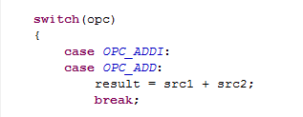
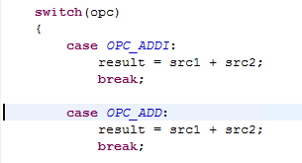
Phase 2 – switch Syntax
In a C switch statement, 2 ways to implement cases
Multiple cases for a single function (as in Phase1_orig)
Separate function for each case
Can mix and match these

Slide 8
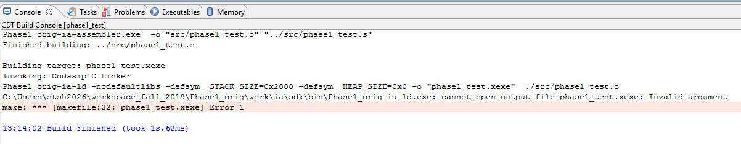
Phase 2 Common Error #1
You have tried to build the program when a simulation was running

Slide 9
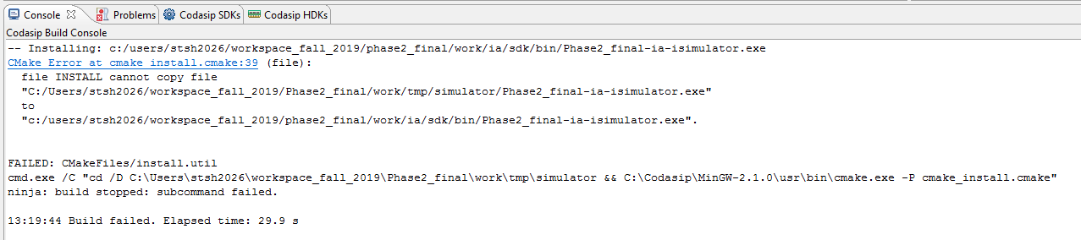
Phase 2 Common Error #2
You have tried to build the hardware project when a simulation was running
Always terminate the simulation with the red button before you do anything else

Slide 10
Registers vs Memory
Registers are faster to access than memory
add x5, x6, x7
Operating on memory data requires loads and stores
More instructions required to be executed
lw x5, 0(x19)
add x5, x5, x7
sw x5, 0(x19)
Compiler must use registers for variables as much as possible
Only “spill” to memory for less frequently used variables
Register optimization is important!
Example of “Make the Common Case Fast”

Slide 11
RISC-V: Registers (convention)
x0: the constant value 0 (hardwired)
x1: return address
x2: stack pointer
x3: global pointer
x4: thread pointer
x5-x7, x28-x31: temporaries
x8: frame pointer
x9, x18-x27: saved registers
x10-x11: function arguments / results
x12-x17: function arguments

Slide 12
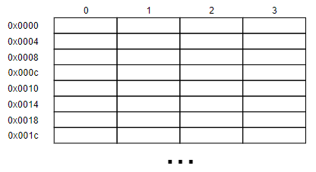
Instruction Memory
RISC-V has an Instruction Memory
Accessed by the Program Counter (PC)
Byte addresses, but only word accesses
Can be at the same addresses as the Data Memory
In the Class Project, memories will be separate

Slide 13
RISC-V: Conditional Branch Instructions
Instructions are fetched from the Instruction Memory at an address specified by the Program Counter (PC)
After a normal fetch, PC increments by 4 (byte address)
Branches and jumps load the PC with a different value

Slide 14
RISC-V: Conditional Branch Instructions
Conditional branches load the PC based on a comparison of two registers
branch x7, x8, 0x10 // If x7 and x8 satisfy the branch condition, // PC = PC + 0x10
// else PC = PC + 4
Similar to Immediate instructions (2 registers + 12-bit signed immediate, the branch offset)

Slide 15
RISC-V: Conditional Branch Instructions
6 Branch Instructions
beq – branch if registers equal
bne – branch if registers not equal
blt – branch if register 1 < register 2 (as signed numbers)
bltu – branch if register 1 < register 2 (as unsigned numbers)
bge – branch if register 1 >= register 2 (as signed numbers)
bgeu – branch if register 1 >= register 2 (as unsigned numbers)
Immediate (called the “branch offset”) is a signed value
In Assembly Language the target is usually a label, and the Assembler computes the branch offset from the label address

Slide 16
Signed vs. Unsigned Conditional Branches
Signed comparison: blt, bge
Unsigned comparison: bltu, bgeu
Example
x22 = 1111 1111 1111 1111 1111 1111 1111 1111
x23 = 0000 0000 0000 0000 0000 0000 0000 0001
x22 < x23 // signed
–1 < +1
x22 > x23 // unsigned
+4,294,967,295 > +1

Slide 17
RISC-V: Conditional Branch Instructions
There isn’t a bgt instruction – why? (POLL)
Can create it from other instructions
bgt x2, x3, TARGET is the same as
blt x3, x2, TARGET
There are several Pseudo Instructions like this to make writing Assembly Language easier

Slide 18
RISC-V: Jump Instructions
Jumps are unconditional branches with special characteristics
jal x5, 0x12348 (Jump And Link) – J-type (UJ-type in book)
Load register x5 with (Current PC + 4)
Set PC to (Current PC + 0x12348)
jalr x5, 0x24(x6) (Jump And Link Register) – I-type
Load register x5 with (Current PC + 4)
Set PC to (Value in register x6 + 0x24)
Similar to Immediate instructions (2 registers + 12-bit signed immediate)

Slide 19
Procedure Call
Steps required
Place parameters (arguments) in registers x10 to x17
Transfer control to procedure
Perform procedure’s operations
Place result in register for caller
Return to place of call + 1 instruction (address in x1)
Definition: Return Address is the address that a called procedure uses to return to the caller procedure.

Slide 20
Procedure Call Instructions
Procedure call: jump and link
jal x22, ProcedureLabel
Address of following instruction (PC + 4) is put in register x22
Jumps to target address defined by ProcedureLable (20 bit address)
Using x0 as destination creates a normal jump (x0 cannot be changed)
Procedure return: jump and link register
jalr x17, offset(x22)
Address of following instruction (PC + 4) is put in register x17
Jumps to target address which is offset + x22
x0 is typically the register used as the destination in the JALR
Can also be used for vectored branches
e.g. for case/switch statements
Can generate odd (i.e. illegal) instruction addresses

Slide 21
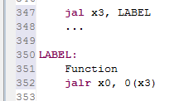
JAL/JALR Example
Call the function at LABEL
PC + 4 -> x3
Execute the function
Return to return address
Can save return address here too

Slide 22
RISC-V: Jump Instructions
jalr also allows the implemented of a VECTORED BRANCH
Assume register x9 contains the base of a table (TABLE) in the Instruction Memory
Assume register x10 contains an offset into that table
add x7, x9, x10 // Get the specific pointer into x7
jalr x5, 0x0(x7) // Branch to selected routine
TABLE: // Routine 1
TABLE + 16: // Routine 2
TABLE + 32: // Routine 3

Slide 23
RISC-V: Upper Immediate Instructions
Since the standard immediate is in the lower 12 bits, we need a way to create a 32-bit constant
20-bit Immediate in upper 20 bits, 0 in lower bits
lui x22, 0x12345 (Load Upper Immediate)
=> x22 = 0x12345000
No sign extension required

Slide 24
RISC-V: 32-bit Constants
Do you see a potential issue with this two instruction sequence? (P)
What happens with the 12th bit of the addi immediate? (P)
Most constants are small
12-bit immediate is sufficient
For the occasional 32-bit constant (e.g. 0x003D0500)
lui rd, constant
Copies 20-bit constant to bits [31:12] of rd
Extends bit 31 to bits [63:32] if 64-bit CPU
Clears bits [11:0] of rd to 0
lui x19, 976 // 0x003D0
0000 0000 0000 0000
0000 0000 0000 0000
0000 0000 0011 1101 0000
0000 0000 0000
addi x19,x19,128 // 0x500
0000 0000 0000 0000
0000 0000 0000 0000
0000 0000 0011 1101 0000
0101 0000 0000

Slide 25
RISC-V: 32-bit Constants
If the 12 bit is a negative sign bit, “1,” the following sequence will work and will be used in your Codasip Project
It will work in all cases, “1” or “0” sign bit in the 12-bit imm.
Assuming 32-bit registers as in the course Codasip Project
lui x19, 976 // 0x3d0
addi x5, x0, 2548 // 0xd48
slli x5, x5, 20 // push the 20 sign extended bits out of reg
srli x5, x5, 20 // right justify 12 bit constant
add x19, x19, x5 // combine for 32-bit constant (0x003d0d48)
How could we implement 1 new instruction to save 3?

Slide 26
RISC-V: 32-bit Constants
Create an “unsigned immediate”, say addiu
Assuming 32-bit registers as in the course Codasip Project
lui x19, 976 // 0x003d0(000)
addiu x19, x19, 2548 // 0x(00000)d48 – NOT SIGN EXTENDED
slli x5, x5, 20 // push the 20 sign extended bits out of reg
srli x5, x5, 20 // right justify 12 bit constant
sdd x19, x19, x5 // combine for 32-bit constant (0x003d0d48)

